Slide 1
ASD ECHO ASSESSMENT
Dr.Rakesh .K
Senior Resident

Slide 2
ASD-8-10% - CHD in childern.
20-40% -CHD in adults
OS ASD-75%
OP ASD-15-20%
Sinus venous ASD-2-10%
CS ASD- <1%(Asso heterotaxty syndromes)

Slide 3
Genetics
NKX2.5/CSX→OS-ASD (AD)
Transcription factors→TBX5,GATA4,GATA6 &TBX20→OS-ASD
TBX-5→Holt Oram syndrome(OS-ASD,UL abnormalities & AV conduction delay)
Noonam,Down,Klinefelter,Williams,Kabuki,Goldenhar & Ellis-van Creveld→OS-ASD

Slide 4
Maternal /Environmental Fcators
Gestational Diabetes mellitus
Phenylketonuria
Maternal Influenza
Exposure to retinoids
NSAIDs
Anticonvulsants
Thalidomode
Smoking
Alcohol

Slide 5
The atrial septum has three components
Septum primum
Septum secundum
Atrioventricular (AV) canal septum.
The sinus venosus is not a component of the true atrial septum.
Septal defects can be classified according to their anatomic location in the IAS

Slide 6
29adys
33days
37days
55days

Slide 8
OS-ASD
Occurs at central IAS (fossa ovalis).
Due to true deficiency of septum primum.
Can occur rarely due to deficient growth of septum secondum.
Superior limbic band of the septum secundum is absent (High OS-ASD)
Left-sided juxtaposition of the atrial appendages
OS-ASDs can enlarge over time with age and cardiac growth.

Slide 9
ASD Natural history
Mean age of death-37.5±5
75% die by 50 years & 90% by 60 years
<5mm ASD in infants spontaneously closes
ASD >8-10mm unlikely to close.
ASD>10mm size can ↑in size noted in 65%.
PHTN,R→L shunt, atrial arrythmias,RVF,
Eisenmengerisation late in ASD > VSD > PDA.

Slide 10
Ostium Primum- ASD/Partial AVCD
Seen in the inferior IAS.
As part of the spectrum of AV canal defects
Common AV valve annulus and two AV valve orifices.
Both AV valve in same line.
Two bridging leaflets (instead of AML & STL) that straddle from the RV→LV.
Cleft left ‘mitral valve’

Slide 11
Sinus venous ASD
Ectopic or incomplete incorporation of right horn of sinus venosus.
Deficiency of wall that separate RUPV from SVC-SVC type
Deficiency of wall that separate RLPV and/or RMPV and the RA -IVC type
90-95 % associated with PAPVD
IVC type very rare

Slide 12
CS-ASD
Left horn of sinous venosus is involved.
Raghib syndrome CS-ASD+ L-SVC.
Shunt -LA→ Dilated CS→RA
Failure of development of wall b/w CS and left artium.
In contrast echo (left UL vein contrast) →CS →may spill over to LA→RA.
Device closure possible in Type 3 CS-ASD
Types
Type-1-complete unroofed CS with LSVC
Type-2-complete unroofed CS without LSVC
Type-3-unroofed at mid portion of CS
Type 4-unroofed at terminal portion

Slide 13
Atrial Septal Aneurysm
It is a redundancy or saccular deformity of the atrial septum.
ASA is defined as ,
Excursion of the septal tissue of greater than 10 mm from the plane of the atrial septum into the RA or LA.
A combined total excursion right and left of 15mm
The prevalence of ASA is 2%–3%.
Associated with PFO.
Increased prevalence of cryptogenic stroke and other embolic events.

Slide 14
Eustachian Valve
Remnant of the valve of the IVC.
A large eustachian valve with PFO→paradoxical embolism
The eustachian valve extends anterior from the IVC–RA junction.
Chiari network
Remnant of the right valve of the sinus venosus
Filamentous structure in various places in the RA.
Chiari network -2%–3% of population
It is associated with PFO and ASA

Slide 16
ASD associations
Crucial for survival in HLHS,D-TGA,Tricuspid Atresia,TAPVC
Cleft L- AV valve(Partial AVCD) – OP-ASD
PAPVC in 90-95 % of sinus venosus ASD.
PS
LSVC in CS ASD.
Non compaction of ventricle
Apical HCM
Rheumatic MS

Slide 17
Orientation of atrial septum
Axial Cut section
Coronal/Frontal cut
Left

Slide 18
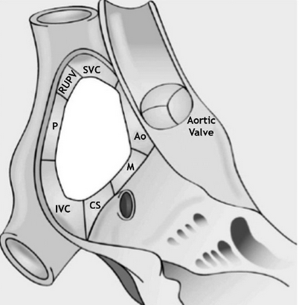
Rims of ASD

Slide 19
ASD Rims
1. Aortic rim/Superior-anterior rim
2. AV valve rim/ Inferior-anterior rim
3. SVC rim/Superior-posterior rim
4. IVC rim/Inferior-posterior rim
5. Posterior rim
6. RUPV rim/Part of Postrosuperior rim

Slide 20
Echocardiography in ASD
Detection
Quantification of the size and shape
The rims of tissue surrounding the defect
The degree and direction of shunting
Associated cardiac anomalies
Remodeling and changes in size and function of the cardiac chambers
Pulmonary circulation.
Aids in device closure
Detection of post procedure complication.

Slide 21
Indirect echo evidence
RV dilation & RA dilation in apical 4 chamber view
IAS drop out in apical 4 chamber view
Abnormal IVS movements i.e-diastolic flattening and early systolic recovery of this flattening.
Relative atrial index-(RA area/LA area)ratio >0.92 has a 99% sensitivity for ASD detection.

Slide 22
Direct view of ASD is possible in
Subcostal Coronal view.
Subcostal Saggital view.
Subcostal left anterior oblique view
Left PSAX
Apical 5 chamber view.
Apical 4 chamber view.
Modified 4c view.
En face view (modified views)
Best viewed in TEE also

Slide 23
ASD TTE Views ,ASE GUIDELINES & STANDARDS:J Am Soc Echocardiogr 2015;28:910-58

Slide 24
Sub costal 4 chamber view (coronal/Frontal view)
Probe marker is at 3° O clock position.
From axial to cranial tilt.
Viewed with breath held in inspiration
Perpendicular to atiral septum (antroposteriorly).
OS-ASD-90% identified.
OP-ASD also identified –posterior tilt.
L- SVC and RUPV can be identified.
Inferior anterior rim(mitral rim) & Posterior rim identification.

Slide 25
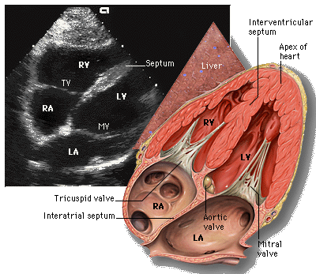
Coronal subcostal view

Slide 27
Sub costal 4 chamber view

Slide 28
Sub costal sagittal view
Probe marker is at 6° O clock position.
From left to right tilt
Profile the atrial septum from left posterior to right anterior.
Size of ASD can be assessed in cranio-caudal axis.
Posterior inferior rim(IVC rim) , Posterior superior rim(SVC rim ) & CS rim (some times)
Excellent window to image a sinus venosus type defect

Slide 29
Sub costal sagittal plane

Slide 31
Posterior
Anterior

Slide 32
Subcostal sagittal view

Slide 33
Apical 4 chamber view
Not ideal for OS-ASD
Far field
Parallel with atrial septum
Echo drop out in fossa ovalis area
Can identify malalignement of septum in OP- ASD.
Used to assess the hemodynamic consequences of ASD.
Also in contrast echo.

Slide 34
Left PSAX
IAS runs posteriorly from NCC of aortic valve.
Not seen entirely as a result of drop out artifact.
Anterior superior rim (Aortic rim) can be profiled.
Posterior rim can be assessed.
RVOT,MPA dilatation
Apical 5 chamber view- Anterior aspect of inter atrial septum
Modified Apical 4-Chamber view
Half way in between Apical 4 chamber and PSAX.
Useful in those with poor subcostal window

Slide 35
Subcostal Left Anterior Oblique
Acquired by turning ~ 45° counterclockwise from the subcostal four-chamber view.
The length of the atrial septum..
Ideal to identify OP-ASD.
CS dilation.
The relation of the SVC & RUPV to the defect.

Slide 36
Subcostal Left Anterior Oblique

Slide 37
High Right Parasternal View
Parasagittal view
Right lateral decubitus position
Probe in the superior–inferior orientation.
Septum is aligned perpendicular to the beam.
Ideal for diagnosing sinus venosus defects.

Slide 38
High Right Parasternal View

Slide 39
Supra sternal short axis view/Crab view
Help to identify all PV drainage

Slide 41
En Face Views of ASDs on 2D TTE
Two methods
4c view→ rotate 45-60° counterclockwise keeping same position
Notes:
°

Slide 42
4c veiw →rotate 45-60° & 20° angulation to right shoulder → Parasternal 4 vessel or 3 vessel veiw→ slight angulation to left

Slide 43
Role of Colour Doppler, CW Doppler & PW Doppler
Should be as co-axial as possible
Narrow pressure difference (~5mmHg)
Interference with pulmonary vein and AV valve flow.
ASD flow pattern- Maximum L→ R during late diastoli and late systoli.
Transient R→L flow may be seen in rapid filling phase and early systoli.

Slide 44
Pulse wave spectral Doppler can be used for the detection of bidirectional shunting.
The color scale settings should be adjusted to 25–40 cm/ sec to optimize for the expected low velocity of shunting

Slide 45
PW Doppler through ASD

Slide 46
Contrast Echocardiography
Apical 4 chamber view
Agitated saline 5-7ml(5ml saline +1ml air)
Contrast spill over to LA can occur even if flow is L→ R (valsalva maneure- release phase)
Bubble quantification grades
Grade -I-up to 5 bubbles
Grade-II-up to 25 bubbles
Grade-III- >25 bubbles
Grade-IV-Opacification of chamber
Bushra et al JACC 2010 VOL. 3, NO. 7, 2010
Direct sign of L→ R shunt -Negative contrast effect(“ghosting”)

Slide 47
Pulmonary AV fistula- it takes 3-8 cardiac cycle for contrast spill over
False positive effects of Negative contrast effect seen in
IVC blood flow
Coronary sinus flow
Gerbode defect
Not quantitative
False impression of PHTN

Slide 48
Role of TEE ASD
Most accurate
Sensitivity~100%
It is must prior to device closure in adult.
Can clearly identify the size, shape, number of defects, rims of ASD.
Contrast study can be combined.
PAPVD, CS -ASD best identified
AVCD can also delineated

Slide 49
TEE basics
Patient position -left lateral decubitus
Topical anesthesia
4-6 hr fasting & NPO at least 1hour after TEE
Introduce in unlock position
Avoid entry into pyriform fossa
Clock wise rotation-Probe turn to right & vice versa

Slide 50
Probe Positions Relative To Esophagus

Slide 51
Upper esophageal(20-30 cm)
Mid esophageal(30-40 cm)
Transgastric (40-45 cm)
Deep transgastric (45-50 cm)

Slide 52
Basic maneuvers

Slide 53
TEE views basics
(0° view)
(90°view)

Slide 55
Views for assessment of ASD by TEE ASE GUIDELINES & STANDARDS: J Am Soc Echocardiogr 2015;28:910-58

Slide 56
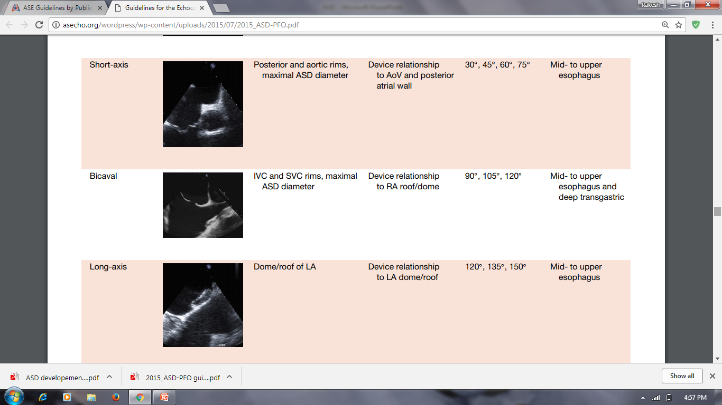
Views for assessment of ASD by TEE ASE GUIDELINES & STANDARDS: J Am Soc Echocardiogr 2015;28:910-58

Slide 57
Important view in ASD
Upper esophageal short-axis view
Midesophageal aortic valve (AoV) short-axis view
Midesophageal four-chamber view
Midesophageal bicaval view
Midesophageal long-axis view.

Slide 58
Upper Esophageal Short-Axis View
Upper esophagus at 0°,15°,30° and 45°.
In this view
Superior aspects of the atrial septum
The roofs of the RA and LA
SVC , Ascending aorta, RUPV
Help to see SVC type of sinus venosus ASD & PAPAV

Slide 59
Upper Esophageal Short-Axis View

Slide 60
Mid esophageal Aortic Valve Short-Axis View
At 0°,30°,45°,60° and 75°
This view facilitates antroposterior diameter of ASD.
Aortic rim and posterior rims measured
The overlap of septum primum and septum secundum when a PFO is present

Slide 61
Mid esophageal Aortic Valve Short-Axis View

Slide 62
Mid esophageal Aortic Valve Short-Axis View

Slide 64
Mid esophageal Four-Chamber View
30-40cm mid-esophagus
At 0°,15°& 30°
This view is used to evaluate,
The AV septum (deficient in primum ASD)
The relationship of any ASD to the AV valves.(if planning larger device )

Slide 65
Mid esophageal Four-Chamber View

Slide 66
Mid esophageal Four-Chamber View

Slide 67
Mid esophageal Bicaval View
Mid esophagus at 90°, 105°, and 120°
It is used to image the inferior and superior plane of the atrial septum.
SVC & IVC rim best assessed
SVC and RUPV
Sinus venous ASD, PAPVD
Eustachial valve well profiled

Slide 68
Mid esophageal Bicaval View

Slide 70
Mid esophageal Bicaval View

Slide 72
Mid-Esophageal Long-Axis View
Obtained at 120°, 135°, and 150°.
Evaluate the roof or dome of the LA.
On rotation to left –LUPV & LLPV entry in to LA

Slide 73
Mid-Esophageal Long-Axis View

Slide 74
3D TTE/TEE ECHO
Avoids potential bias due to mal alignment of the ultrasound planes
Full volume 3D data set aquires in 4-7 cardiac cycles
Multiple orthogonal views possible.
Surrounding structures clearly viewed
ASD size, shape, rims assessment more accurate.

Slide 75
3D ECHO
Ideal window is the mid esophageal bicaval view
Mid esophageal TEE at 0° with zoom & TUPLE maneure gives best en face view.
Real time 3D TEE aids in percutanenous device closure procedure.
RT 3D imaging shows the changing shape of the ASD during a cardiac cycle, with maximum size in diastole.

Slide 76
3D TEE

Slide 77
3D TEE

Slide 78
RT 3D TEE

Slide 79
Intracardiac echocardiography(ICE)
Probe-9-10MHz
Two type -Rotational / phased array ICE.
Assess ASD size and rims
Pulmonary veins assessment
Position of sheath and guide wire can be determined.
Additional defects can also be assessed

Slide 80
ICE
Imaging modality for transcatheter closure guidance.
Comparable image quality to TEE
Need 8-10 F sheath to introduce.
Need no assistance from others during procedure.
Can produce arrhythmia
Far field view limitation present (5cm)

Slide 81
(A) Home view. (B) Septal long-axis view. (C) Bicaval view. (D) Septal short-axis view of PFO. (E) Septal short-axis view of ostium secundum ASD.

Slide 82
Advantage of Various ECHO modalities
Modality | Advantages
TTE | Readily available Low cost Unlimited multiple planes to evaluate IAS Noninvasive Does not require any additional sedation Excellent image quality in pediatric patients
TEE | Improved image quality over TTE 3D technique adds incremental value over 2D technique in evaluating ASD size, shape, location and provides en face images.
ICE | Comparable image quality to TEE Can be performed with patient under conscious sedation Reduces procedure and fluoroscopy times Superior to TEE for evaluating inferior aspects of IAS Interventionalist can perform without additional support

Slide 83
Draw backs of Various ECHO modalities
Modality | Drawbacks
TTE | Image quality in larger patients could be suboptimal Requires technologist to perform study during closure Lower rim of IAS not well seen after device.
TEE | Requires additional anesthesia to perform Risks include aspiration and esophageal trauma Requires additional echocardiographic operator to perform Patient discomfort
ICE | Invasive Needs of 8F–10F venous access and catheter Vascular risk and arrhythmia Cost of single-use ICE catheters Limited far field views with some systems Need for additional training of ICE operator Operator might have two tasks (imaging and procedure)

Slide 85
Hemodynamic in ASD
Primarily related to the direction and magnitude of shunting.
Size of the defect
The relative compliance of the RV and LV
The relative systemic and pulmonary vascular resistances
Compliance RV > LV
Resistance PVR < SVR
So usually the shunt is L→R

Slide 86
RV volume overload
D shaped septum in diastole
RV diameter > 41 mm at the base
RV diameter >35 mm at the midlevel
RV longitudinal dimension > 83 mm
RV Volume Index > 87 ml/m2 in males & > 74ml/m2 in females indicates RV voulme overload.
3D echo is measures are preferred
RV/LV minor axis index >1 =RV enlargement

Slide 87
Pulmonary Artery Hypertension
PHTN-Earlier in Sinus venous ASD than OS –ASD.
PA Pressure = RVSP ( TR gradient + RAP)
If no Pulmonary stenosis
Diastolic PA Pressure = PR gradient + Mean RAP
Mean PA pressure = peak PA velocity
PVR= (TR velocity(m/s)/VTI rvot(cm)) × 10 +0.16 {not very accurate}

Slide 88
Peak PA pressure < 70% of SBP is an indication for ASD device closure.
In pediatric patients, ASD can produce peak pul valve gardient upto 30mmHg.
>30mmHg PV gradient →Asso.PS

Slide 89
PHTN Vs ASD device closure
T. Akagi / Journal of Cardiology 65 (2015) 17–25

Slide 90
RV Function
Needs to be evaluated prior to closure
RV systolic function
dP/dt
Myocardial performance index
Tricuspid annular plane systolic excursion
RV fractional area change
3D RV EF
Doppler tissue imaging (DTI) S0 velocity
DTI isovolumic myocardial acceleration
RV strain and strain rate
RV diastolic function
Trans tricuspid E and A wave velocities
E/A ratio
DTI E0 and A0 velocities
E/E0 ratio
Isovolumic relaxation time
Deceleration time

Slide 91
LV function
Very important especially in elderly before ASD closure
Age ↑→LVEDP↑ → ↑ L→R shunt
If LVEDP high and ASD closure done→acute pulmonaty odema
Masking effect of LVEDP measures due to the pressure equalization between the left heart and right heart due to ASD
Trial occlusion of ASD and monitor for ↑ LA pr.

Slide 92
Stop flow method –Balloon device sizing
Sizing balloon is passed through the ASD
Inflated till no flow is detected with Colour Doppler.
Deflated and L→R flow verified Doppler
Again inflated keeping the balloon in the center of IAS a waist may form and no flow confirmed by Colour Doppler
This waist diameter is the ASD maximum diameter

Slide 94
Stop flow method
The hemodynamic effect can be studied
ASD device closure should not be done,if mean PCWP increased > 10 mmHg from the baseline value or PCWP increased >20 mmHg in test balloon occlusion.
Creation of a fenestration hall on the device.

Slide 95
Hemodynamic assessment
If isolated ASD is there,
Qp/Qs can be calculated as
PA flow/Aortic flow = PA CSA × PA VTI/Aortic CSA × Aortic VTI
Closure - Qp/Qs >1.5 & PVR < 5 wood unit or less than 2/3 of SVR.

Slide 97
Importance of ASD Rims
<5mm rim size is considered deficient
Adequate SVC, RUPV, IVC, and AV valve rims are important for successful device closure of ASD.
Aortic rim < 5mm is not a contraindication
Aortic rim < 5mm is a potential risk factor for cardiac erosion.
All measurements to be taken in ventricular end systole

Slide 99
Indication for ASD closure
Baumgartner H et al. ESC Guideline for the management of grown-up congenital heart disease
(2010). Eur. H. J (2010) 31; 2915-2957

Slide 100
Indication for ASD closure
Baumgartner H et al. ESC Guideline for the management of grown-up congenital heart disease
(2010). Eur. H. J (2010) 31; 2915-2957

Slide 102
Devices
U.S. FDA approved device
Amplatzer Septal Occulder- defects up to 35 mm
Gore Helex Septal Occulder device -defects up to 17 to18 mm
Helex device -may be used in deficient anterior rims.

Slide 103
ASD device closure Challenges
Size > 30mm
LUPV or RUPV technique may be adopted
Balloon assist technique
Elderly
PHTN
RV dysfunction
Masked ↑LVEDP

Slide 104
ASD Device closure complication
Device embolisation
Residual ASD/missed additional ASDs
Accidental incorporation of Eustachian valve in to device
Hemolysis
Cardiac Erosion

Slide 106
Referance
Braunwald's Heart Disease, A Textbook of Cardiovascular Medicine.10th edition
Moss and Adams' Heart Disease in Infants, Children, and Adolescents. 9th Edition
Feigenbaum's Echocardiography.7th edition
ESC Guidelines for the management of grown-up congenital heart disease.2010
Guidelines for Performing a Comprehensive Transesophageal chocardiographic Examination:Recommendations from the American Society of Echocardiography and the Society of Cardiovascular Anesthesiologists.J Am Soc Echocardiogr 2013;26:921-64.)
Various articles in Circulation & JACC

Slide 107
Question-1
Maximum diameter of ASD is in
Early systole
Late systole
Early diastole
Late diastole

Slide 108
Question 2
Most common defect in OS-ASD
a)Inferior posterior rim
b)Inferior anterior rim
c)Central defect
d)Multiple rim

Slide 109
Question 3
Aortic rim In TEE is seen in
Mid esophageal 0º
Mid esophageal 40º
Mid esophageal 90º
Gastroesophageal jn retroflexed

Slide 110
Question 4
IVC rim and SVC rim is evaluated in (TEE) mid esophageal
90º
50º
0º
140º

Slide 111
Question 5 Identify the defect

Slide 112
Question 6 Identify the defects

Slide 113
Thank you

